Slide 1
Credit Card Fraud Detection System
Abayomi Adesina
Andres Porras
Madhan Murugan
Surshita Cheripalli

Slide 2
Introduction
In today's digital age, the prevalence of online transactions has significantly increased, providing consumers with unparalleled convenience and accessibility. However, this surge in online activity has also led to a rise in fraudulent activities, particularly in the realm of credit card transactions. Credit card fraud poses a substantial threat to both consumers and financial institutions, resulting in billions of dollars lost annually. As a result, the need for effective fraud detection mechanisms has never been more critical.

Slide 3
Problem Statement
This project aims to develop a robust credit card fraud detection system utilizing advanced machine learning techniques. By leveraging data-driven approaches, we can identify and mitigate fraudulent activities in real-time, enhancing the security of electronic transactions. Our system will analyze transaction patterns and behaviors to distinguish between legitimate and fraudulent activities, thereby safeguarding consumers and reducing financial losses.

Slide 4
Problem Goal
Our variable column "fraud" will be our target variable. This column indicates whether the transaction was fraudulent (1 for fraud, 0 for not fraud).
We will predict whether a transaction is fraudulent or not based on the other variables.
Distance_from_home: the distance from home where the transaction happened.
Distance_from_last_transaction: the distance from last transaction happened.
Ratio_to_median_purchase_price: Ratio of purchased price transaction to median purchase price.
Repeat_retailer: Is the transaction happened from same retailer.
Used_chip: Is the transaction through chip (credit card).
Used_pin_number: Is the transaction happened by using PIN number.
Online_order: Is the transaction an online order.
Fraud: Is the transaction fraudulent.

Slide 5
Data Collection & Data Cleaning
We applied various data preprocessing techniques, including outlier removal, and handling of missing values - delete, impute, to clean and prepare our dataset for analysis.
We utilized StatExplore to identity important variables for our dataset. Others were removed.
StatExplore enhanced us to efficiently evaluate the connections between different variables and their relevance to the target variable.

Slide 6
Analysis Approach
Our team has decided to incorporate a range of analytical approaches to evaluate our Credit Card Fraud model. We compared its performance against the following SAS techniques:
StatExplore
Neural Networks
Decision Trees
  Gradient Boosting
  4-Branch, 12-Deep Model
  2-Branch, 6-Deep Model
  HP Forest
Logistic Regression

Slide 7
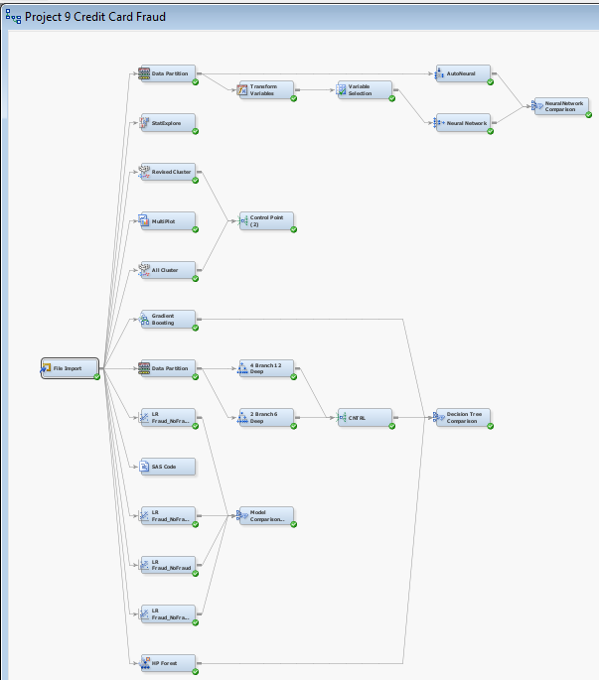
SAS Diagram

Slide 8
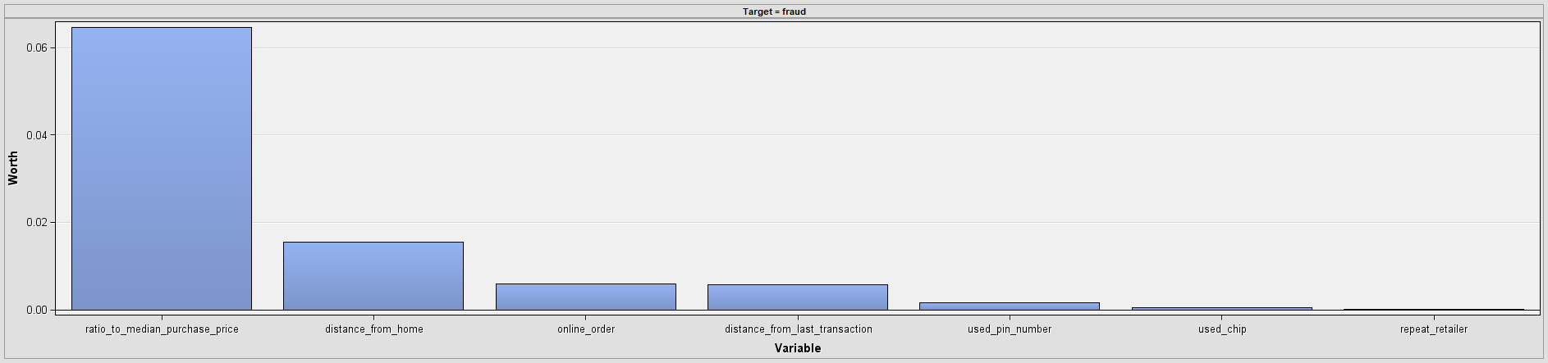
SAS StatExplore
Most Important Variable:
  ratio_to_median_purchase_price has the highest worth. This suggests:
    Fraud is closely related to how a transactions amount compares to the median purchase price.
    Transactions significantly deviating from the median are more likely to be fraudulent.
Notes:
Most Important Variable:
ratio_to_median_purchase_price has the highest worth. This suggests:
Fraud is closely related to how a transactions amount compares to the median purchase price.
Transactions significantly deviating from the median are more likely to be fraudulent.
Moderately Important Variables:
distance_from_home and online_order have notable worth:
distance_from_home: Fraud is more likely when transactions occur far from the cardholder's home.
online_order: Online transactions may have a higher fraud risk due to reduced physical verification.
Less Important Variables:
Variables like distance_from_last_transaction, used_pin_number, and used_chip contribute less to predicting fraud.
used_chip: Transactions with chip usage may indicate secure transactions, reducing their fraud likelihood.
repeat_retailer: Repeat transactions at the same retailer have minimal impact on fraud detection.

Slide 9
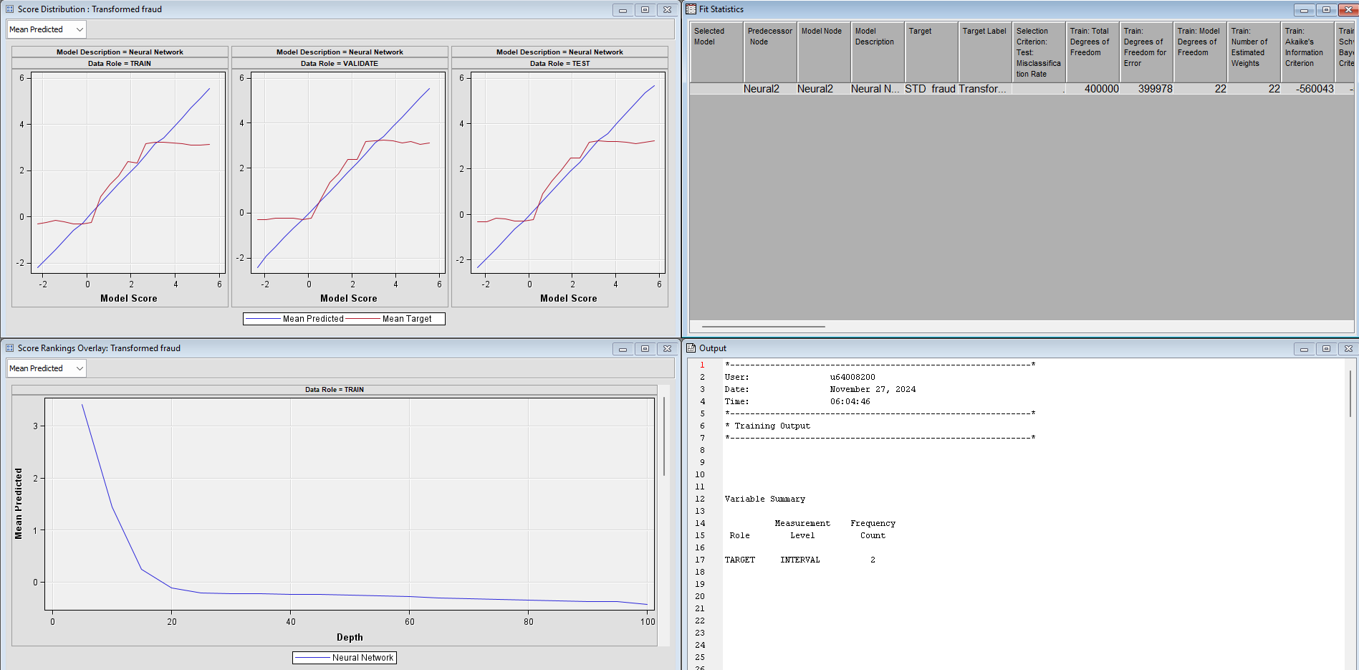
SAS Model - Neural Network

Slide 10
Neural Network - Analysis
Alignment of Red and Blue Lines:
  Good Fit: In all three panels of the score distribution (Train, Validate, Test), the blue line (Mean Predicted) closely follows the red line (Mean Target), indicating that the model is accurately predicting the target variable across datasets.
  Normalization: The alignment across Validate and Test datasets shows that the model is not overfitting to the training data.
Linear Relationship:
  The near-linear relationship between Model Score and Mean Target indicates that higher model scores are strongly correlated with higher probabilities of the positive class (fraud). This suggests the neural network is effectively distinguishing between fraud and non-fraud cases.
Notes:
Alignment of Red and Blue Lines:
Good Fit: In all three panels (Train, Validate, Test), the blue line (Mean Predicted) closely follows the red line (Mean Target), indicating that the model is accurately predicting the target variable across datasets.
Generalization: The alignment across Validate and Test datasets shows that the model is not overfitting to the training data.
Linear Relationship:
The near-linear relationship between Model Score and Mean Target indicates that higher model scores are strongly correlated with higher probabilities of the positive class (fraud). This suggests the neural network is effectively distinguishing between fraud and non-fraud cases.
Performance Consistency:
The similarity in the patterns across Train, Validate, and Test datasets suggests the model performs consistently and generalizes well to unseen data.

Slide 11
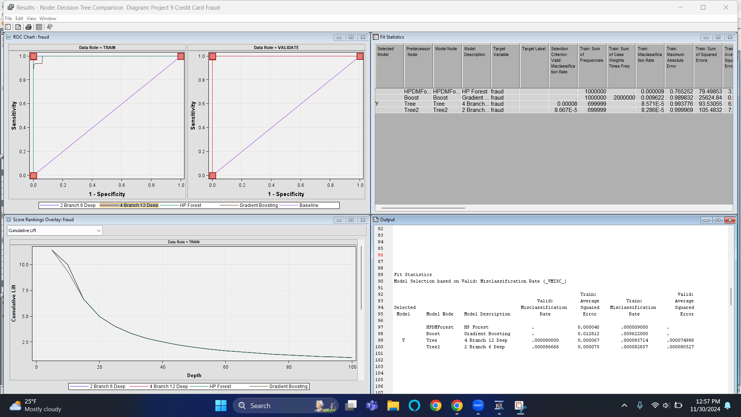
SAS Model - Decision Tree

Slide 12
Decision Tree - Analysis
Diagram Comparison and Model Description
Our group decided to compare four models under the Decision Tree:
    HP Forest Boost: A high-performance boosting model.
    Gradient Boosting: a method that builds models one after another, with each new model fixing the mistakes of the previous one. It reduces errors by using simple models (like decision trees) to focus on the remaining mistakes.
    Decision Tree: Decision Tree with 4 branches and depth 12.
    Decision Tree2: Decision Tree with 2 branches and depth 6.
Best Model Selection:
  The Tree model (4 Branch, 12 Deep) has the lowest validation misclassification rate (0.00008) and average squared error (0.000074988), making it the best-performing model for normalization.
Notes:
This Fit Statistics table in SAS compares the performance of different models (e.g., Decision Trees and Gradient Boosting) based on various metrics like misclassification rate and average squared error for training and validation datasets.
Key Columns in the Output:
Model Description:
Specifies the models being compared:
HP Forest Boost: A high-performance Gradient Boosting model.
Tree: Decision Tree with 4 branches and depth 12.
Tree2: Decision Tree with 2 branches and depth 6.
Valid: Misclassification Rate:
The proportion of incorrect predictions on the validation dataset.
A lower value indicates better performance.
For instance:
Tree: 0.00008 (8 in 100,000 predictions are wrong).
Tree2: 0.000086666.
HP Forest Boost: Not calculated for validation here (.), but it's likely comparable to the training rate.
Train: Misclassification Rate:
The proportion of incorrect predictions on the training dataset.
For example:
Tree: 0.000085714.
Tree2: 0.00002857.
HP Forest Boost: 0.000009000.
Train: Average Squared Error (ASE):
Measures the squared difference between predicted and actual values for the training data.
Lower ASE indicates better model fit.
For example:
Tree: 0.000067.
Tree2: 0.000075.
HP Forest Boost: 0.000040.
Valid: Average Squared Error (ASE):
Same as the train ASE but computed on the validation dataset.
Lower values here indicate better generalization to unseen data.
For example:
Tree: 0.000074988.
Tree2: 0.000080527.
Insights from the Table:
Best Model Selection:
The Tree model (4 Branch, 12 Deep) has the lowest validation misclassification rate (0.00008) and average squared error (0.000074988), making it the best-performing model for normalization.
Although HP Forest Boost has the lowest training misclassification rate (0.000009000), its validation performance is not reported here, making it hard to evaluate its generalization ability.
Complexity and Generalization:
Tree2 (2 Branch, 6 Deep):
Simpler model with fewer branches and depth.
Slightly worse validation performance but may be preferred for interpretability or when computational resources are limited.
Tree (4 Branch, 12 Deep):
More complex and performs better on the validation set.
Overfitting Risk:
The Tree model (4 Branch, 12 Deep) shows a small gap between training and validation misclassification rates, indicating minimal overfitting.
HP Forest Boost may require validation performance metrics to confirm it is not overfitting, as its training misclassification rate is very low.
What This Output Means:
Performance Comparison:
The decision tree models (Tree and Tree2) are being compared against a high-performance Gradient Boosting model (HP Forest Boost).
While Gradient Boosting models are typically more accurate, the specific validation metrics are missing here for HP Forest Boost.
Recommendation:
If you prioritize accuracy and the validation misclassification rate, select the Tree model (4 Branch, 12 Deep).
If interpretability and simplicity are more important, go with Tree2 (2 Branch, 6 Deep).
If validation metrics for HP Forest Boost are available, compare them to the trees, as it might outperform them in unseen data.
Next Steps:
Confirm validation performance for HP Forest Boost if available.
Deploy the best model (Tree) if the goal is balanced accuracy and interpretability.
HP Forest and Gradient Boosting are not the same in SAS, although both are ensemble learning methods. Here's a breakdown of the differences:
Gradient Boosting:
Gradient Boosting is an ensemble technique that builds models sequentially, each new model correcting the errors made by the previous ones. It minimizes the residual errors by fitting weak learners (typically decision trees) to the residuals. It works by optimizing the loss function using gradient descent.
In SAS, Gradient Boosting is implemented through procedures like HPFOREST (for large data) or BOOST.
HP Forest:
HP Forest is an optimized version of a Random Forest model available in SAS, specifically designed for high-performance environments and large datasets. It uses bagging (Bootstrap Aggregating) to build multiple decision trees on random samples of the data, and then aggregates the predictions.
Unlike Gradient Boosting, HP Forest does not focus on correcting errors iteratively; rather, it builds several trees independently and combines their results.
Key Differences:
HP Forest (Random Forest) uses bagging, while Gradient Boosting uses boosting.
Gradient Boosting focuses on sequentially reducing errors, while HP Forest builds trees independently.
HP Forest is optimized for high-performance computing with large datasets, while Gradient Boosting can be slower due to its iterative nature.
In summary, Gradient Boosting and HP Forest (Random Forest) are both ensemble methods, but they differ in their approach to model building and error correction.

Slide 13
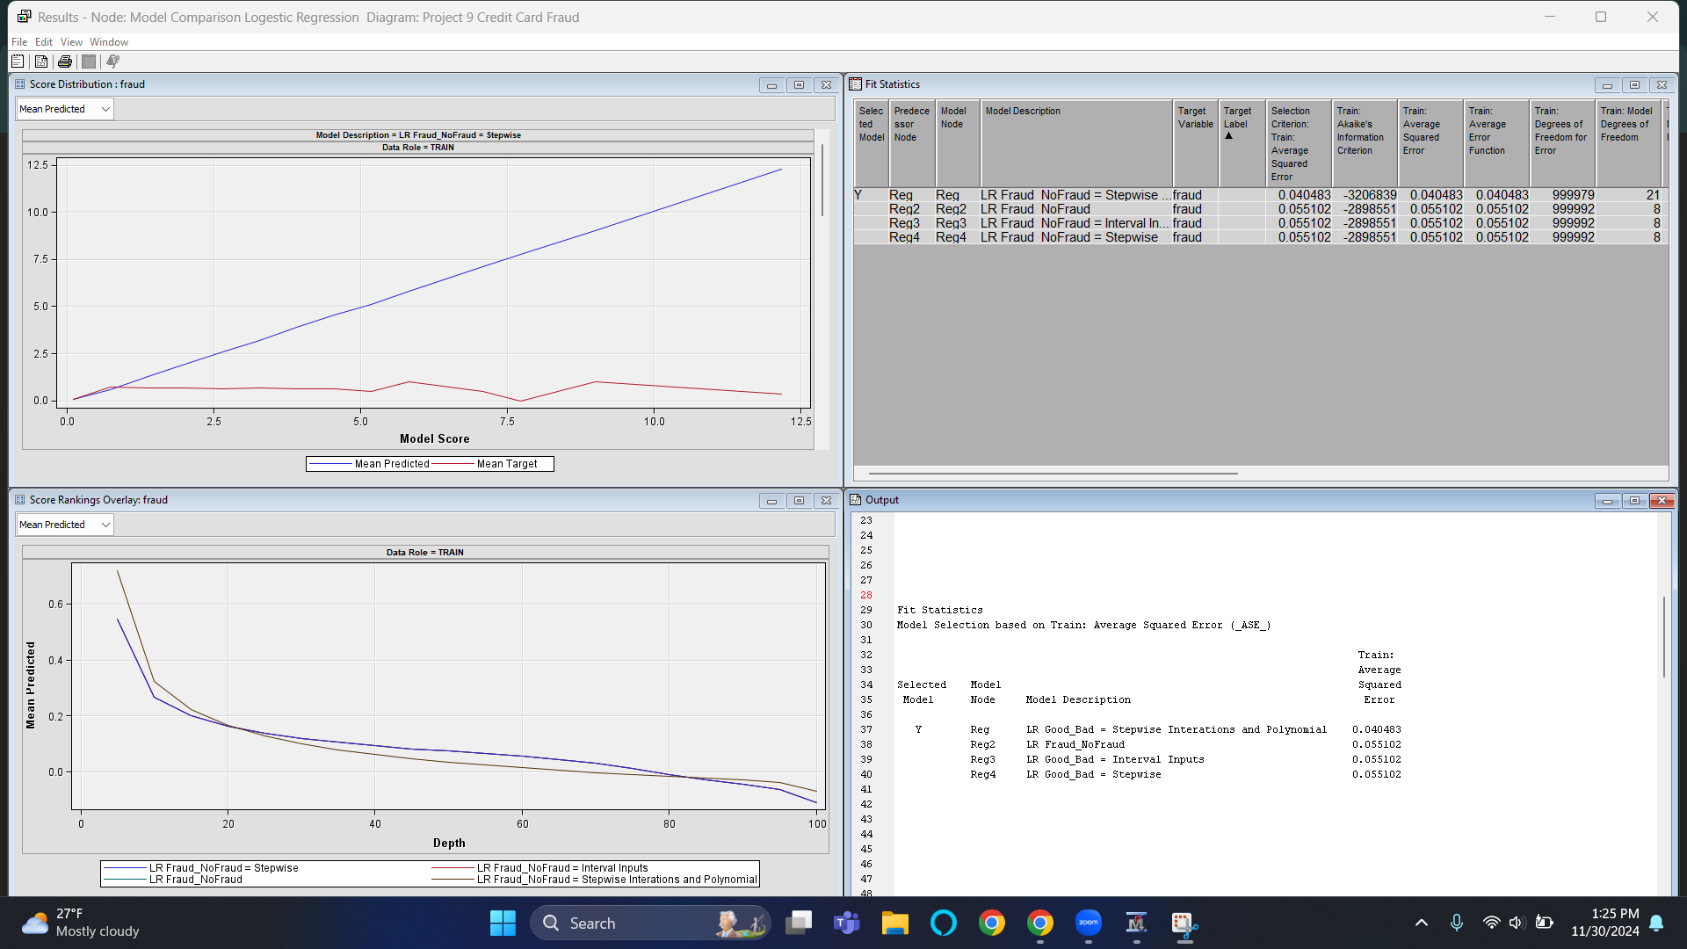
SAS Model - Logistic Regression

Slide 14
Logistic Regression - Analysis
Diagram Comparison and Model Description
Our group decided to compare different models under the Decision Tree:
    LR Good_Bad – Stepwise Interactions and Polynomial: Includes stepwise-selected interactions and polynomial terms for features.
    LR Fraud_NoFraud: Logistic regression for binary fraud prediction.
    LR Good_Bad – Interval Inputs.
    LR Good_Bad – Stepwise: Logistic regression with stepwise feature selection.
Best Model Selection:
  The LR Good_Bad – Stepwise Interactions and Polynomial model has the lowest Average Squared Error (ASE) (0.040483), making it the best-performing model.
Notes:
This Logistic Regression output in SAS provides insights into the performance of a logistic regression model trained to predict fraud (Fraud vs No-Fraud).
Key Elements in the Graph:
Model Description:
Describes the model as a Logistic Regression (LR) with stepwise selection (indicating variables were added/removed to optimize the model).
Data Role = TRAIN:
The graph shows the model's performance on the training dataset.
X-Axis: Model Score:
Represents the predicted scores from the logistic regression model. These scores are often probabilities that indicate the likelihood of a transaction being classified as fraud.
Y-Axis:
Represents the values of:
Mean Predicted (Blue Line): The average predicted value from the logistic regression model for each score range.
Mean Target (Red Line): The actual average target value (proportion of fraud cases) for the same score range.
Insights from the Graph:
Disparity Between Predicted and Target Values:
The blue line (Mean Predicted) shows the logistic regression model's predictions increase steadily with higher model scores.
The red line (Mean Target) does not align closely with the blue line, indicating that the model may not perfectly capture the relationship between features and the target variable.
Model Fit on Training Data:
The red line remains relatively flat, suggesting that the proportion of fraud cases does not increase as sharply as the model predicts for higher scores.
This could indicate some bias in the model, where it overestimates fraud likelihood for higher scores.
Potential Issues:
The gap between the blue and red lines suggests a misalignment between the predicted probabilities and the actual observed fraud rates.
This could mean:
The model might be overfitting the training data.
The logistic regression assumptions may not fully capture the data's complexity.
What This Output Means:
Model Prediction Behavior:
The model predicts increasing likelihood of fraud (blue line) as the model score rises, which is expected in logistic regression.
Fit Assessment:
The mismatch between predicted values and actual target values (red line) indicates that the model’s predictions may not fully represent the observed data distribution.
Train: Average Squared Error (ASE):
Measures the mean squared error of the model's predictions on the training dataset.
A lower ASE indicates better model performance in terms of how closely predictions match actual values.

Slide 15
Recommendation
To avoid credit card fraudulent activity online, we recommend you to incorporate best practices like setting up transaction limits, finding credit card fraud education, and even adding multi-factor authentication.
Transaction limits:
  Set limits on transaction sizes or frequency within a certain period to reduce the potential for large-scale fraud.
Implement Multi-Factor Authentication (MFA)
  Enhancing security through MFA requires users to provide multiple forms of verification before completing a transaction. This approach significantly reduces the risk of unauthorized access, as it combines something the user knows (e.g., password) with something the user has (e.g., a mobile device) or something the user is (e.g., biometric data).
Educational Credit Card Preventions
  Learn about safe transaction practices, such as recognizing phishing attempts and safeguarding your personal information, this can empower you to act as the first line of defense against fraud.

Slide 16
Conclusion
We were able to determine that the higher the online transaction away from home. The more likely the transaction was fraudulent.
Also, online transactions tend to be more fraudulent than a transaction where we utilized the chip in store.
Therefore, safeguard your credit card information and educate yourself on ways to fight against FRAUD!

Slide 17
References
https://www.kaggle.com/datasets/dhanushnarayananr/credit-card-fraud/data

